Slide 1

Factory Design Pattern
Factory Design Pattern
Marya Amouri

Slide 2
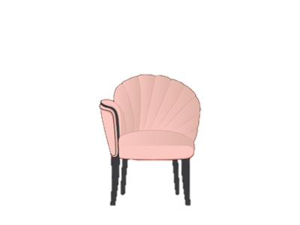
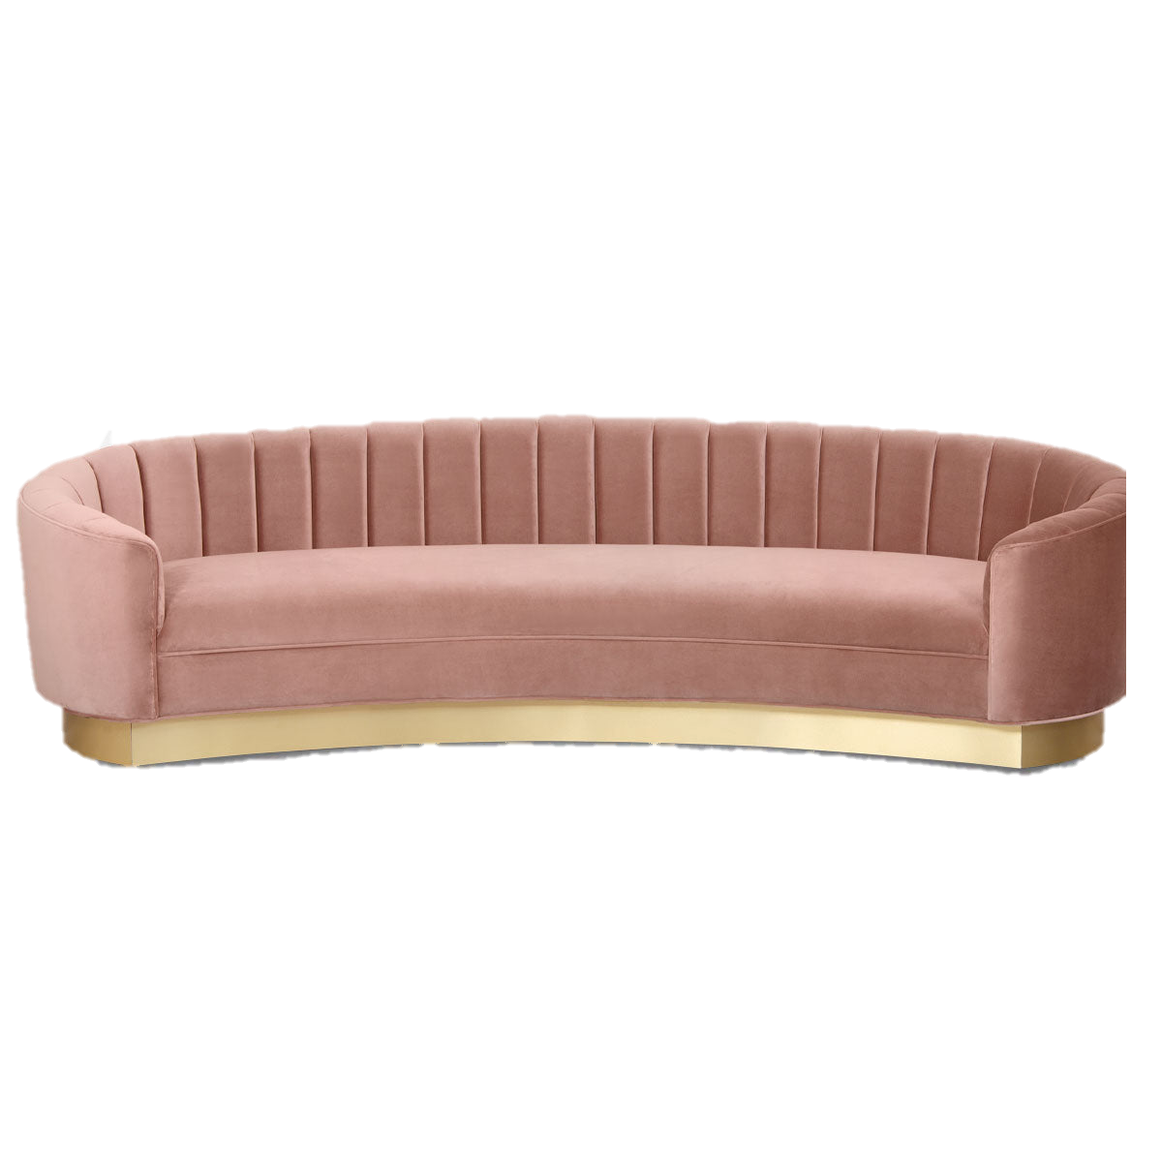
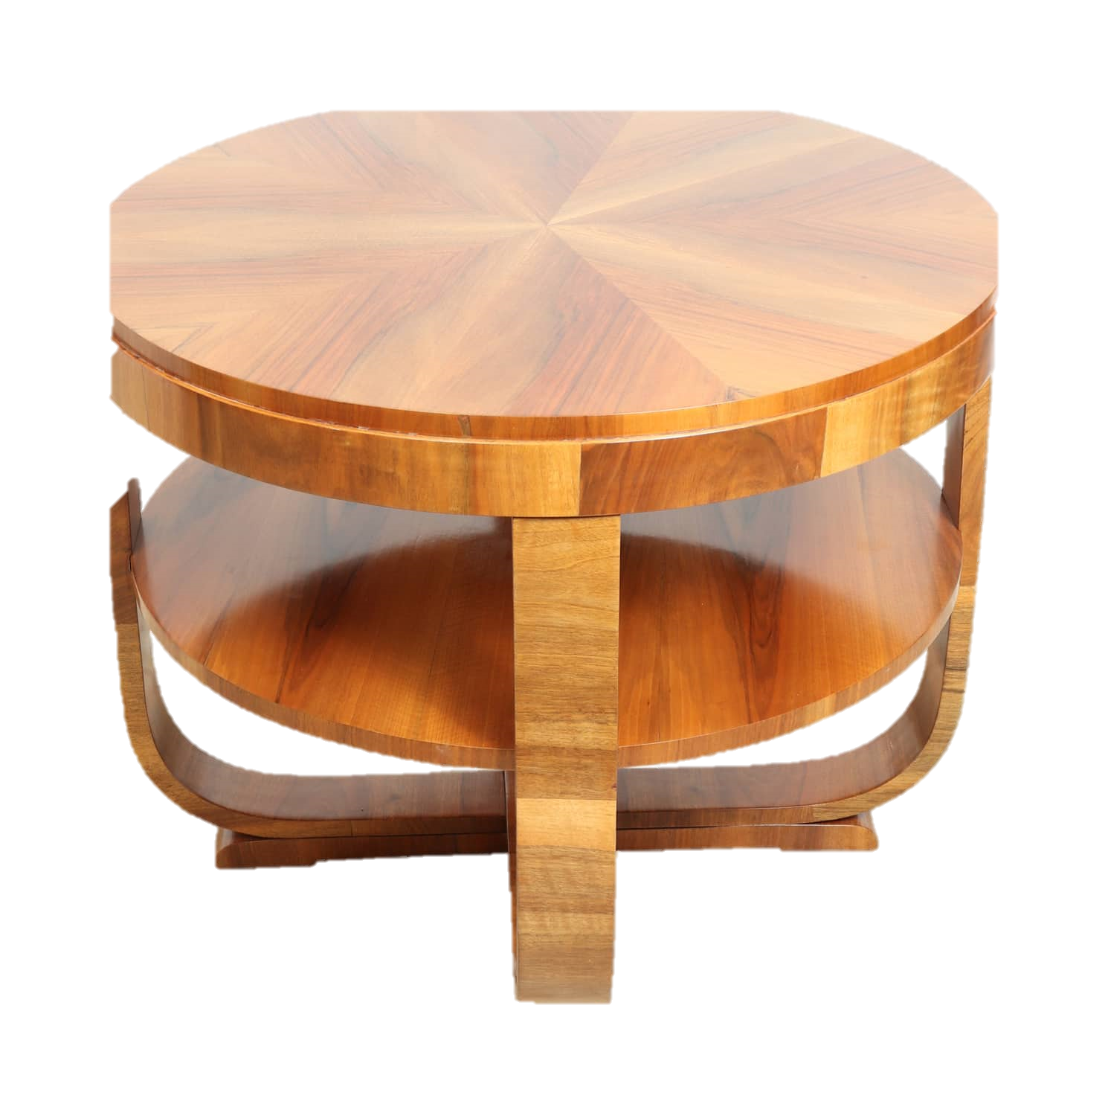
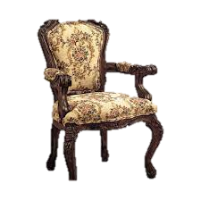
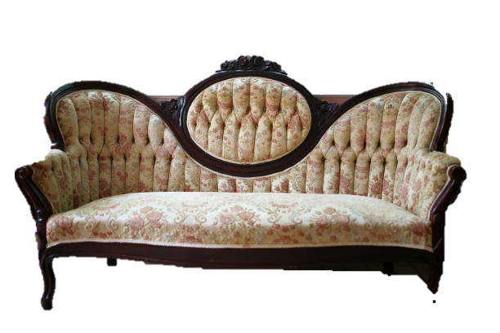
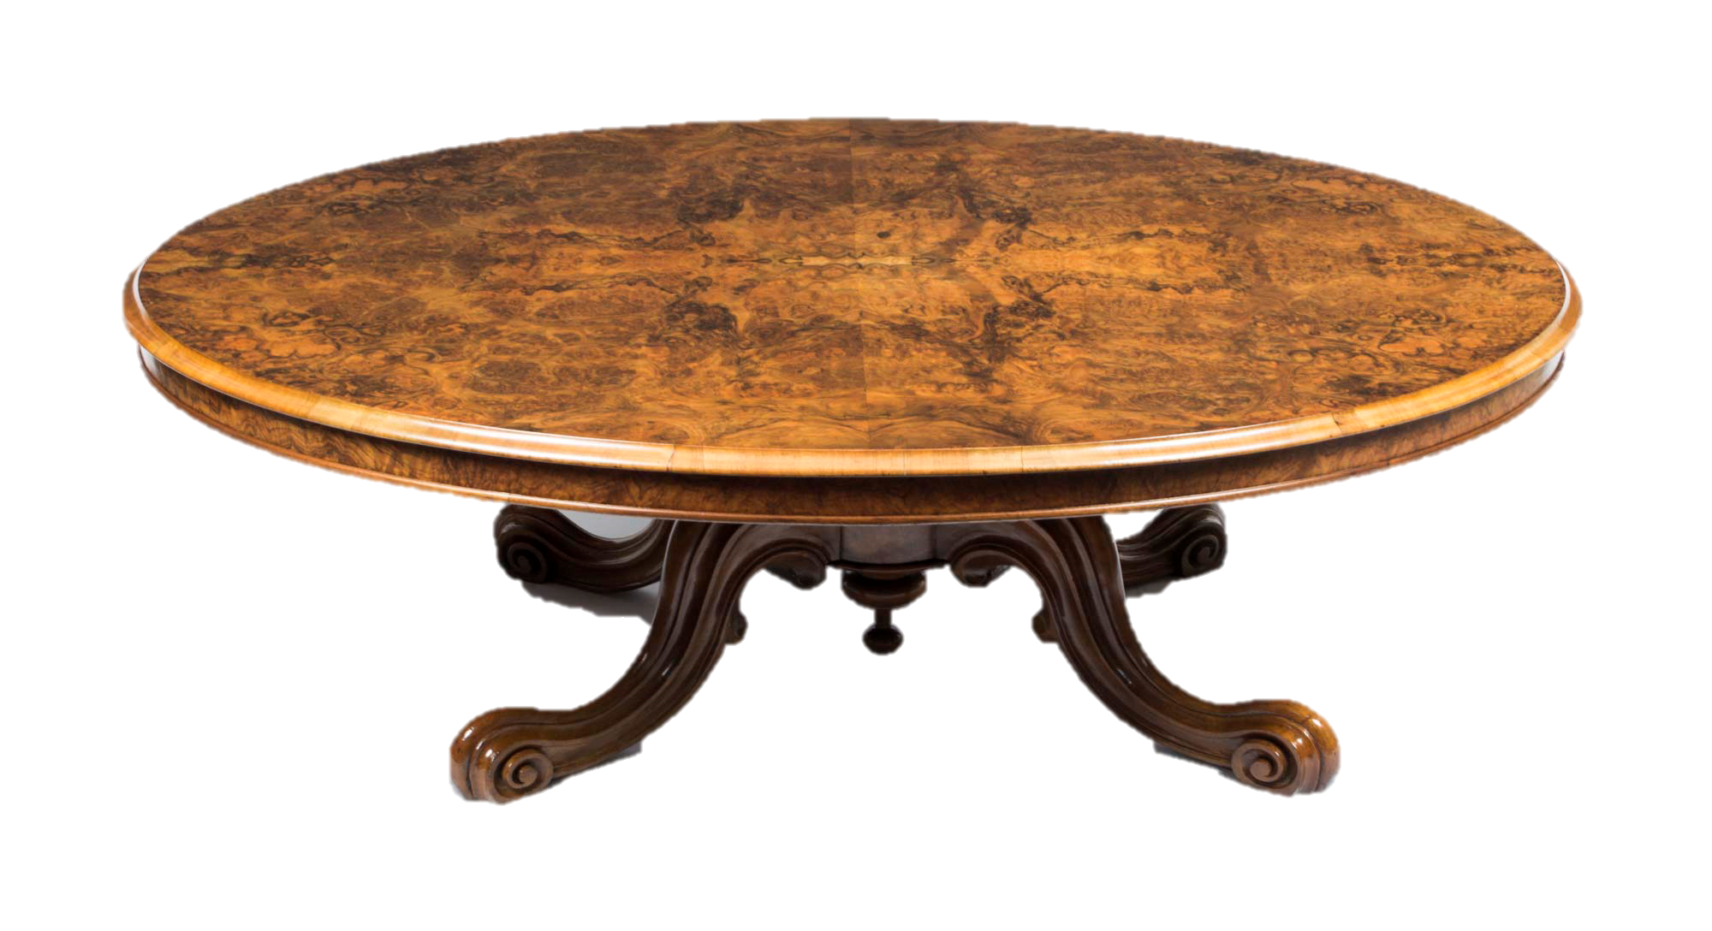
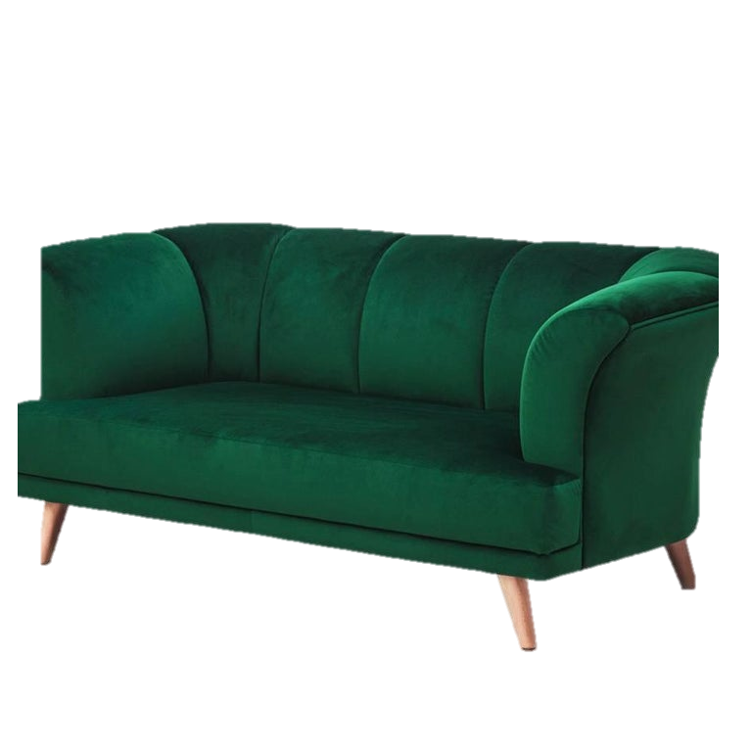
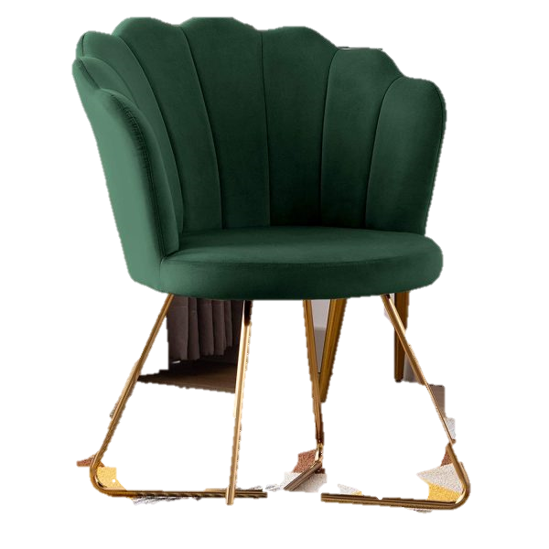
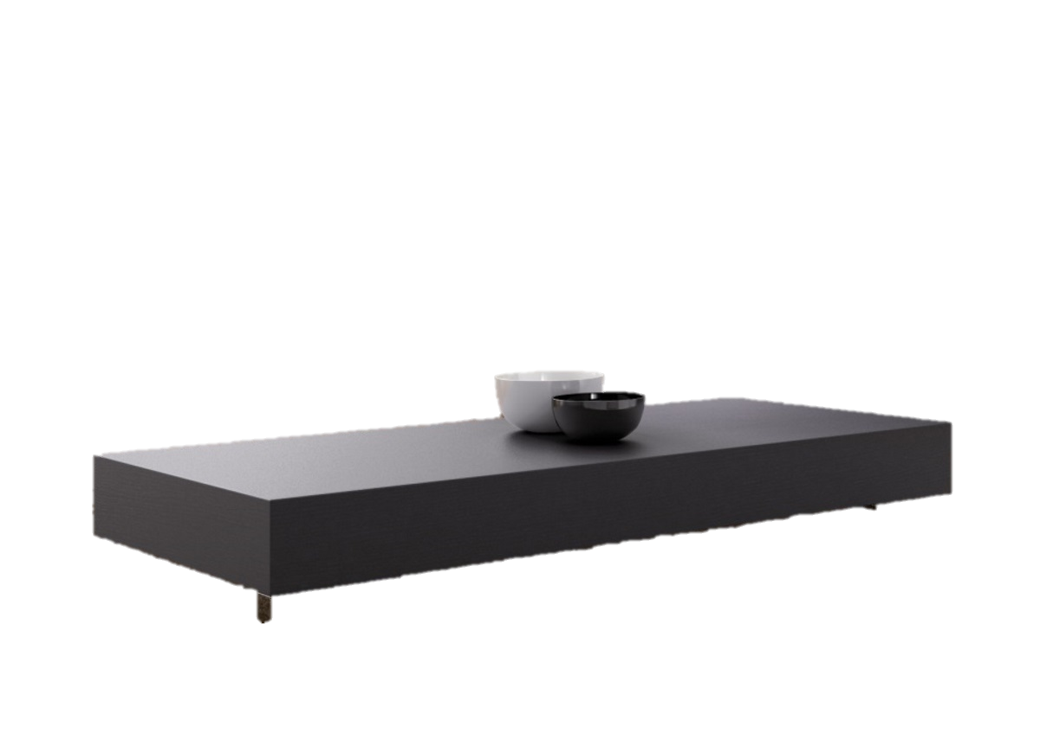
Motivations
IChair
ArtChair
Modern
Chair
Victorian
Chair
ICoffee
Table
Chair
Sofa
Coffee Table
Chair
ArtCoffee
Table
Modern
Coffee
Table
Victorian
Coffee
Table
Art Deco
Victorian
Modern
ISofa
ArtSofa
Modern
Sofa
Victorian
Sofa

Slide 3
Furniture Store Class- Diagram
IChair
ICoffee
Table
ArtChair
Modern
Chair
Victorian
Chair
ArtCoffee
Table
Modern
Coffee
Table
Victorian
Coffee
Table
ISofa
ArtSofa
Modern
Sofa
Victorian
Sofa

Slide 4


Introduction
Factory
Every codebase can be improved
Using factory method is a more extensible alternative
“A factory is an object for creating objects”

Slide 5
Factory
“A factory is an object for creating objects”

Slide 6


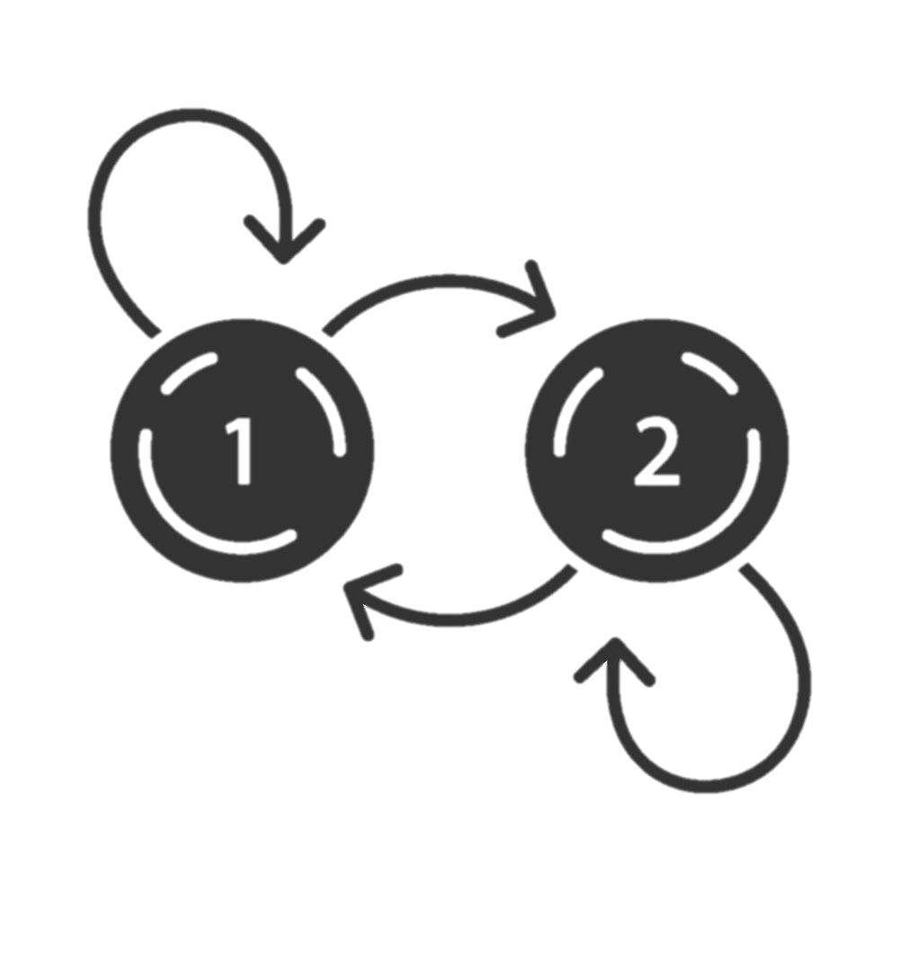

Design Patterns
Creational
Structural
Behavioral

Slide 7
Factory is
Creational
Design Pattern

Slide 8
Factory Characteristics
Client
Creator
Product
Ask for a created product
Facilitates a creation
The product of the creation

Slide 9
Why Factory?
reducing code duplication
single point for objects creation
more modular and extensible code
reusability
more testable code

Slide 10
Coupling
Tight Coupling
Loosing Coupling

Slide 11
Factory Design Pattern Flavors
Simple Factory
Factory Method
Abstract Factory

Slide 12
Simple Factory
A factory class creates and returns instances of various classes based on input parameters.

Slide 13
Factory Method
Each subclass of a superclass provides its own factory method for creating instances of its specific class.

Slide 14

Intent
Factory Method is a creational design pattern that provides an interface for creating objects in a superclass, but allows subclasses to alter the type of objects that will be created

Slide 15
Factory Method
ICreator
FactoryMethod()
Product = FactoryMethod()
IProduct
Operation()
Product
Creator
FactoryMethod()
return concrete Product
Operation()

Slide 16
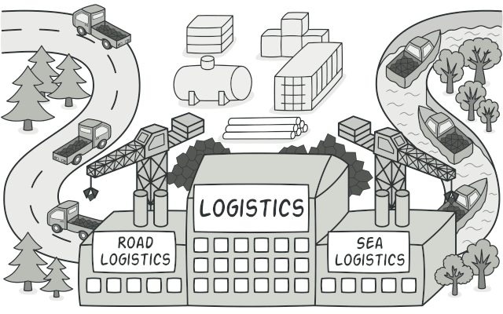

Slide 17
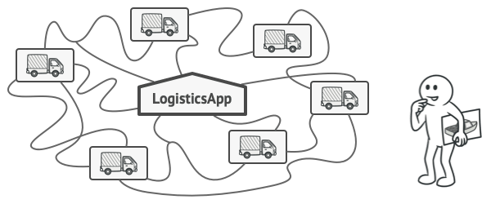
Problem

Slide 18

Problem
When adding Sea Track:
Most of your code is coupled to the Truck class.
Adding Ships into the app would require making changes to the entire codebase.

Slide 19
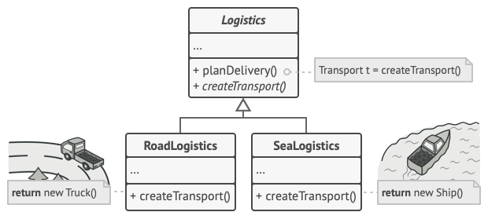
Solution

Slide 20
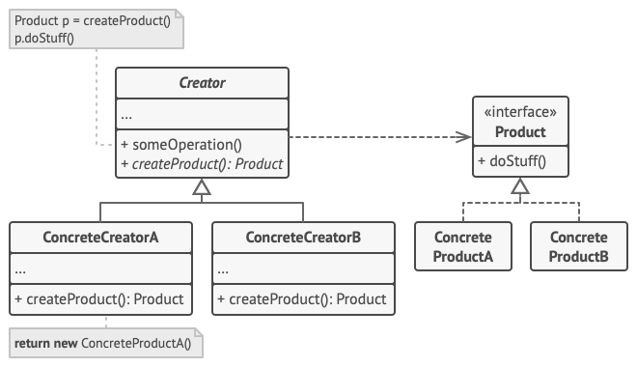
Structure

Slide 21
Demo Code
// Define the interface for the Product
interface IProduct {
void Use();
}
class ProductA : IProduct
{
public void Use() { Console.WriteLine("Using ProductA");
} }
class ProductB : IProduct {
public void Use() {
Console.WriteLine("Using ProductB");
} }

Slide 22
interface IProductFactory {
IProduct CreateProduct();
}
class ProductAFactory : IProductFactory {
public IProduct CreateProduct() {
return new ProductA();
}
}
class ProductBFactory : IProductFactory { public IProduct CreateProduct() {
return new ProductB();
}
}

Slide 23
class Program
{
static void Main(string[] args)
{
IProductFactory factoryA = new ProductAFactory();
IProduct productA = factoryA.CreateProduct();
productA.Use();
IProductFactory factoryB = new ProductBFactory();
IProduct productB = factoryB.CreateProduct();
productB.Use();
}
}

Slide 24
Abstract Factory

Slide 25
Abstract Factory
is a creational design pattern that lets you produce families of related objects without specifying their concrete classes.

Slide 26
Abstract Factory
factory interface is defined that has several factory methods for creating families of related objects

Slide 27
Intent
Provides interface for creating families of related or dependent objects without specifying there concrete classes

Slide 28
Motivations
Chair
Sofa
Coffee Table
Chair
Art Deco
Victorian
Modern

Slide 29
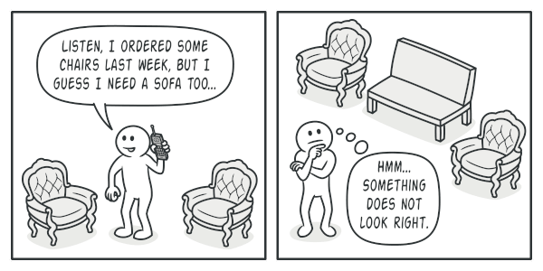
Problem
IChair
ArtChair
Modern
Chair
Victorian
Chair
ICoffee
Table
ArtCoffee
Table
Modern
Coffee
Table
Victorian
Coffee
Table
ISofa
ArtSofa
Modern
Sofa
Victorian
Sofa

Slide 30
Furniture Store Class- Diagram
IChair
ICoffee
Table
ArtChair
Modern
Chair
Victorian
Chair
ArtCoffee
Table
Modern
Coffee
Table
Victorian
Coffee
Table
ISofa
ArtSofa
Modern
Sofa
Victorian
Sofa

Slide 31
Motivations
IChair
ArtChair
Modern
Chair
Victorian
Chair
ICoffee
Table
Chair
Sofa
Coffee Table
Chair
ArtCoffee
Table
Modern
Coffee
Table
Victorian
Coffee
Table
Art Deco
Victorian
Modern
ISofa
ArtSofa
Modern
Sofa
Victorian
Sofa

Slide 32
Motivations
IChair
ArtChair
Modern
Chair
Victorian
Chair
ICoffee
Table
Chair
Sofa
Coffee Table
Chair
ArtCoffee
Table
Modern
Coffee
Table
Victorian
Coffee
Table
Art Deco
Victorian
Modern
ISofa
ArtSofa
Modern
Sofa
Victorian
Sofa

Slide 33
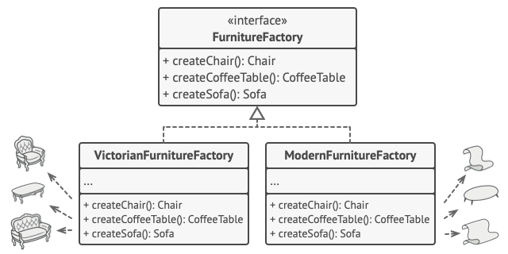
solution

Slide 34
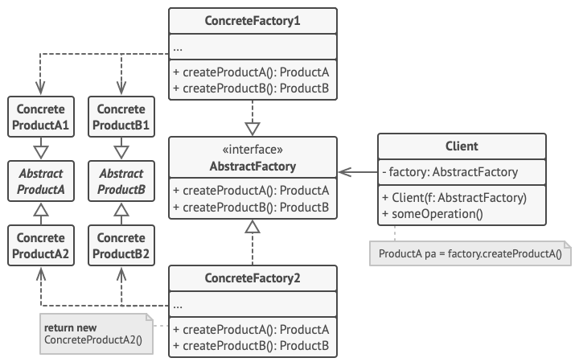
Structure

Slide 35
Code
// Abstract Product A
interface IProductA {stringGetName( );}
// Abstract Product B
interface IProductB { string GetName( ); }

Slide 36
Code
// Concrete Product A1
class ProductA1 : IProductA
{
public string GetName() { return "Product A1"; }
}
// Concrete Product A2 class ProductA2 : IProductA {
public string GetName() { return "Product A2"; }
}

Slide 37
Code
// Concrete Product B1
class ProductB1 : IProductB
{ public string GetName() { return "Product B1"; } }
// Concrete Product B2
class ProductB2 : IProductB
{ public string GetName() { return "Product B2"; } }

Slide 38
Code
// Abstract Creator
interface ICreator {
IProductA CreateProductA();
IProductB CreateProductB(); }
// Concrete Creator 1
class Creator1 : ICreator {
public IProductA CreateProductA() { return new ProductA1(); }
public IProductB CreateProductB() { return new ProductB1(); } }

Slide 39
Code
// Concrete Creator 2
class Creator2 : ICreator {
public IProductA CreateProductA() {return new ProductA2(); }
public IProductB CreateProductB() { return new ProductB2(); } }

Slide 40
Factory method vs Abstract factory
Purpose
Structure
Dependency

Slide 41
Thank You

